Slide 1




Composite UIs: The Microservices Last Mile
Jimmy Bogard
@jbogard
github.com/jbogard
jimmybogard.com

Slide 2
A Brief Microservices Interlude

Slide 3
Microservices is not a technology or stack

Slide 4
Whoever says so is trying to sell you something

Slide 5
What is a microservice? (depends who you ask)

Slide 6
Building Microservices book
Small and focused on doing one thing well
Autonomous
The end!

Slide 7
The smallest, focused autonomous boundary

Slide 8
What is autonomy?
Independent ownership, availability, and delivery
Manage information and access
Handle failures
Maintain contracts

Slide 9
Ideal World

Slide 10
Sales
MVC
Shipping
Win
SQL
SQL
ERP
???
Orders

Slide 11
Sales
MVC
Shipping
Win
SQL
SQL
ERP
???
Orders

Slide 12
Sales
MVC
Shipping
Win
SQL
SQL
ERP
???
Orders

Slide 13
Autonomy is "easy" for backend services

Slide 14
Service boundaries can follow Conway's law
Any organization that designs a system (defined broadly) will produce a design whose structure is a copy of the organization's communication structure.

Slide 15
Sales
MVC
Shipping
Win
SQL
SQL
ERP
???
Orders
1900 to now

Slide 16
Communication styles and constraints remain the same

Slide 17
Latency has shrunk (but is not zero)

Slide 18
As long as we don’t make silly choices, it should "just work"
See: Fallacies of Distributed Computing

Slide 19
But Jimmy aren't we supposed to talk about Composite UIs????

Slide 20
Composite UI circa 1900

Slide 23
The fundamental compositional challenges remain the same

Slide 24
The "last mile" problem
Delivering services to the final end-user

Slide 25
The "last mile" is the most important part!
We can't ignore it

Slide 26
Sales
MVC
Shipping
Win
SQL
SQL
ERP
???
Orders

Slide 27
End-User UI
Sales
MVC
Shipping
Win
SQL
SQL
ERP
???
Orders

Slide 28
Option zero: don’t compose

Slide 29
store.com
sales.store.com
orders.store.com
shipping.store.com
erp.store.com

Slide 30
store.com
sales.store.com
orders.store.com
shipping.store.com
erp.store.com

Slide 31
store.com
sales.store.com
orders.store.com
shipping.store.com
erp.store.com
CDN
Notes:
Benefits
Maximizes autonomy
Completely independent delivery pipelines
Drawbacks
Exposes the "man behind the curtain"
Not necessarily a seamless experience for the customer
Difficult to share anything more substantial

Slide 32
It's hard to fake a composite UI with disparate apps
UX *usually* suffers

Slide 33
Where do we compose?

Slide 34
store.com
Browser
Server
Database

Slide 35
store.com
Browser
Server
Database

Slide 36
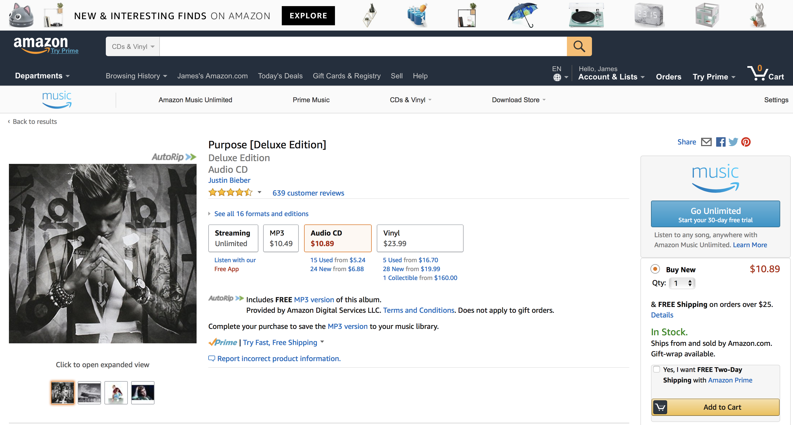

Slide 37
Choose your framework!
Angular modules
React components
Aurelia components
noun.js component

Slide 38
webpack components
component
model
CSS
template
handlers

Slide 39
webpack components
cart component
catalog component
model
services
model
services
template
handlers
template
handlers
account component
shipping component
model
services
model
services
template
handlers
template
handlers

Slide 40
Backing services
cart component
Cart API
catalog component
model
services
model
services
template
handlers
CatalogAPI
template
handlers
account component
shipping component
model
services
model
services
AccountAPI
Shipping API
template
handlers
template
handlers

Slide 42
promos.js

Slide 43
promos.js
account.js

Slide 44
promos.js
account.js
images.js

Slide 45
promos.js
account.js
images.js
formats.js
stock.js
cart.js

Slide 46
Service Team
store.com
api.store.com
api.sales.store.com
api.orders.store.com
api.shipping.store.com
api.erp.store.com

Slide 47
Avoid cross-component chatter
It's a sign your boundaries are wrong

Slide 48
store.com
Browser
Server
Database

Slide 49
Story server-side is…a little messier
And it's highly dependent on your server-side stack

Slide 50
store.com
Model
Controller
View

Slide 51
store.com
Model
Controller
View

Slide 52
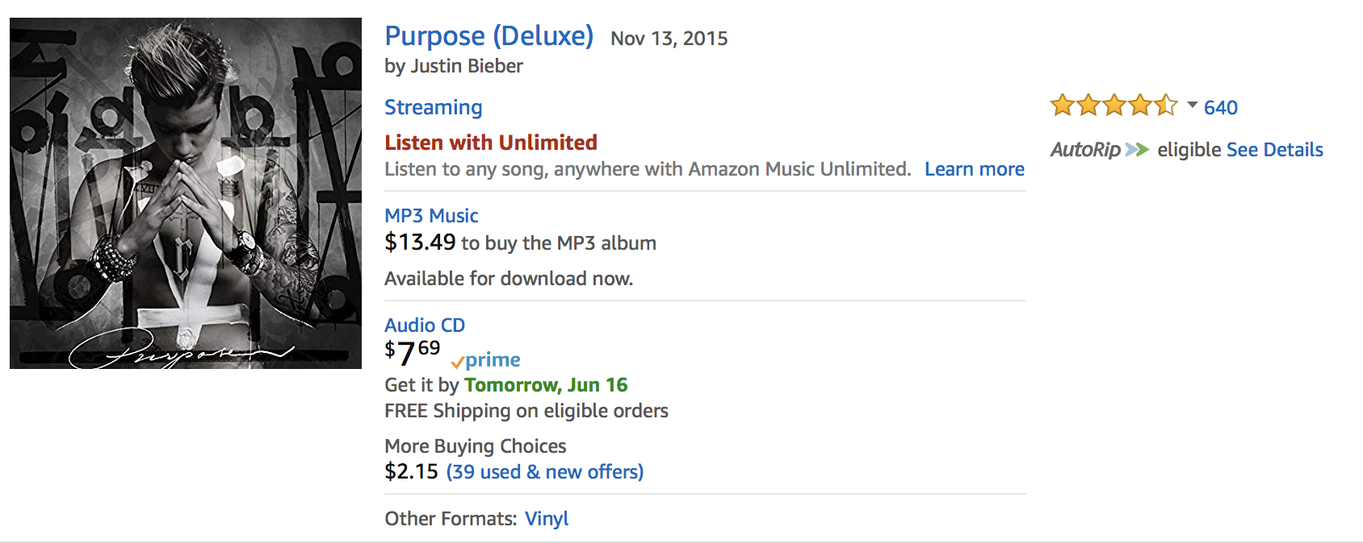

Slide 53
ProductSearchResult

Slide 54
ProductSearchResult
Product Catalog

Slide 55
ProductSearchResult
Product Catalog
Pricing

Slide 56
ProductSearchResult
Product Catalog
Pricing
Ratings

Slide 57
ProductSearchResult
Product Catalog
Pricing
Ratings
Recommendations

Slide 58
ProductSearchResult
Product Catalog
Pricing
Ratings
Recommendations

Slide 59
/products/search?q=…
Product Catalog
Pricing
Ratings
Recommendations

Slide 60
/products/search?q=…
Product Catalog
Pricing
Ratings
Recommendations

Slide 61
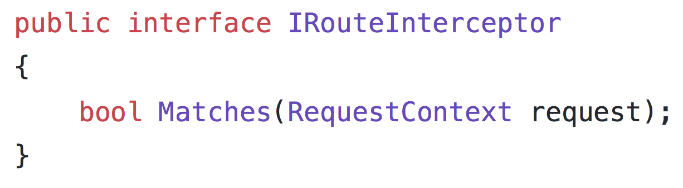

Slide 62
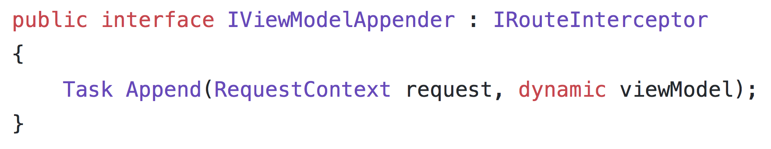

Slide 63
store.com
Model
Controller
View

Slide 64
promos.cshtml
account.cshtml
images.cshtml
formats.cshtml
stock.cshtml
cart.cshtml

Slide 65
ASP.NET Core: View components
Replacement for "child actions"
Encapsulate a mini-request, with invocation, model, and view
Can have parameters and business logic
Invoked from a view (usually a layout)

Slide 66
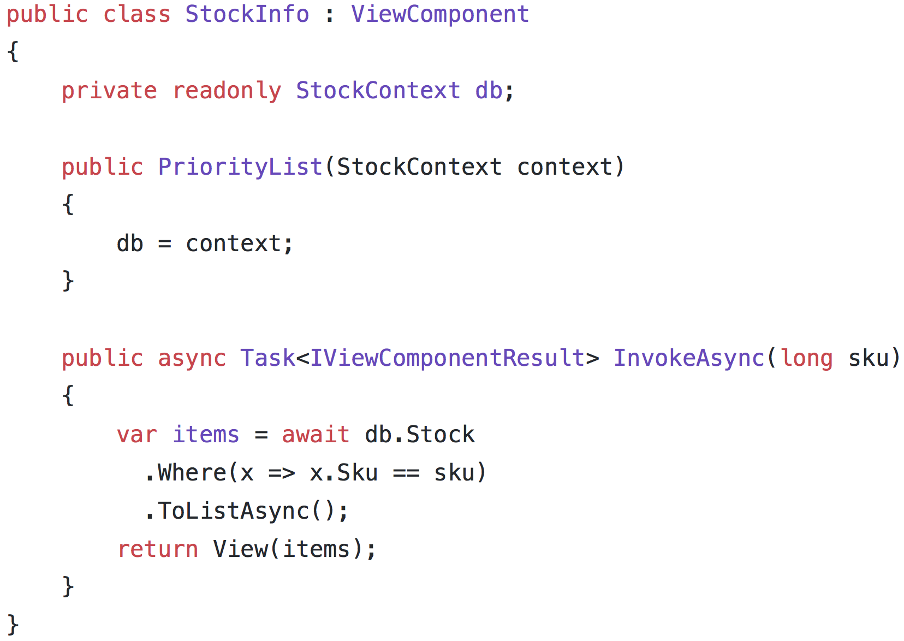

Slide 67
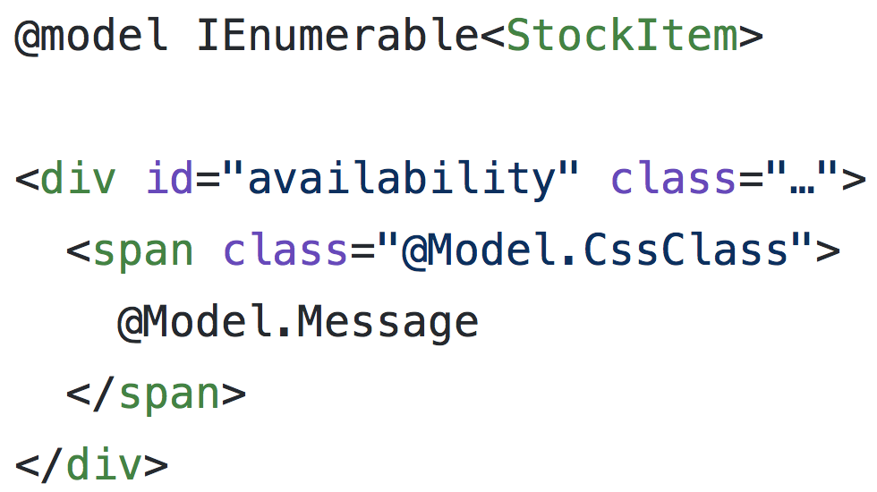

Slide 68
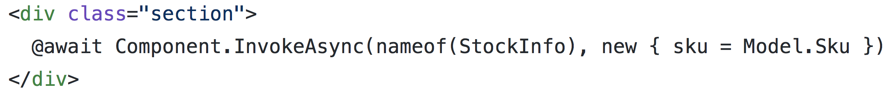

Slide 69
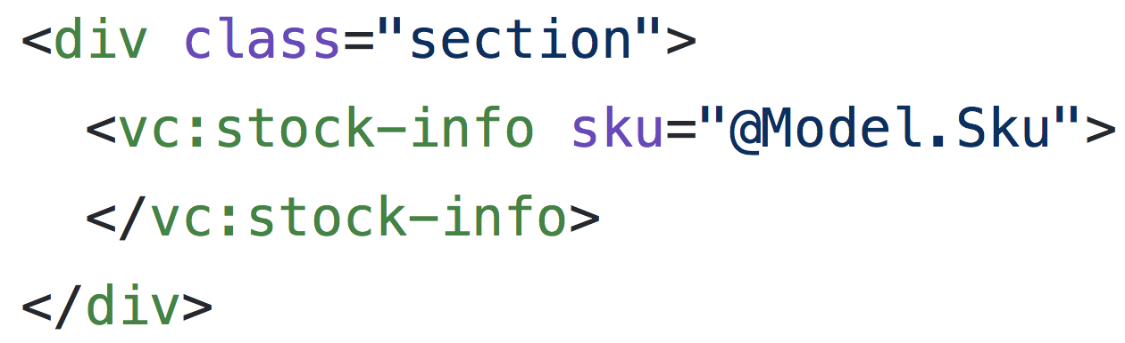

Slide 70
store.com
Browser
Server
Database

Slide 71
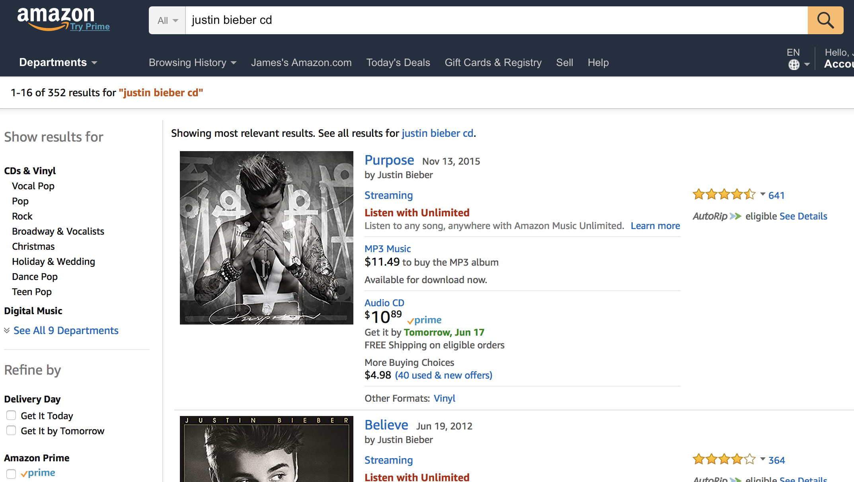

Slide 73
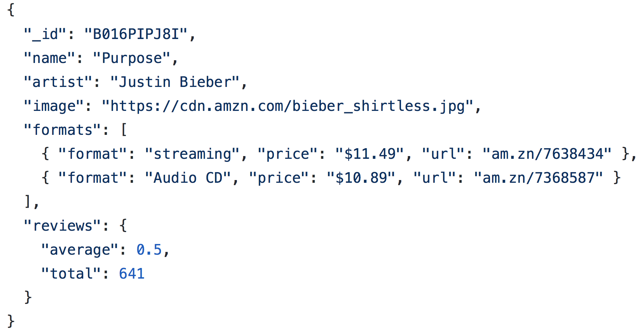

Slide 74
catalog.svc
image.svc
formats.svc
reviews.svc

Slide 75
The Data Duplication Monster!!!

Slide 76
"Immutability changes everything" – Pat Helland

Slide 77
Data ownership
Search owns the shape of the data
Search owns the SLA of response
Search owns the relevance
But none of the data!

Slide 78
store.com Search
denormalizer
catalog.svc
image.svc
formats.svc
reviews.svc

Slide 79
store.com Search
store.com
denormalizer
catalog.svc
image.svc
formats.svc
reviews.svc

Slide 80
Catalog
Known quantity
1/day update
Search
API
Catalog

Slide 81
Images
Served with catalog
Sever connection
Search
Images

Slide 82
Formats
Rarely changes
Serves many internal clients
Existing integration method
Consume files 1/day
…
…
…
Search
Formats
DocDB

Slide 83
Reviews
Changes frequently
Important to react quickly
Triggers inside DB
Messaging to update
Search
Reviews
DB

Slide 84
Key Takeaways
Don't compose before it's necessary
Choose the compositional model based on what's best for the user experience
As always, the fallacies of distributed computing are called FALLACIES for a reason
Front-end can become its own service boundary

Slide 85
Composite UIs: The Microservices Last Mile
Jimmy Bogard
@jbogard
github.com/jbogard
jimmybogard.com

